Slide 1
How I Tracked A Misplaced Android Phone
◎ The Beauty Behind Recovered Lost/ or Misplaced Phone
◎ Various Ways of Carrying out Tracking
◎ Security Tips on Data/Phone Protection
◎ Graphical Explanations on the Steps taken
◎ Closing remarks

Slide 2
The Beauty Behind Recovered Lost/ or Misplaced Phone
The ability to recover a lost or misplaced phone gives joy the heart, having access to your personal data , contacts, confidential files.
Mobile Phones have modern technology, such as tracking features, play sound, delete files capabilities, remote locking which enhances the chances of recovering a lost phone and safeguarding your data.

Slide 3
Various Ways of Carrying out Tracking
A. IMEI Tracking: The International Mobile Equipment Identity (IMEI) number very useful to track a mobile phone or device. Just contact your service provider or police with this unique identifier.
B. Third-Party Tracking Apps: Lots of App, like “Find My Device” (for Android), “Prey” (for iPhone), mSpy (Android & iPhone) These Apps offers cross-platform tracking, remote lock, wipe, and sound alarms.
C. Built-in Phone Settings: “Find My Device” It is a service offers by Google for Android phones which provides similar tracking and remote control capabilities.
D. Antivirus Software with Tracking: Like McAfee and Lookout app offer anti-theft functionality with Antivirus capability.
E. Use of Social Media or Google Maps: If you have Location Service enabled on your phone you may be able to track its last known location through Google Maps or the Social Media apps connected to your phone.

Slide 4
Security Tips on Data/Phone Protection
A. Maintain updated software: Updated operating system and application software do patch security vulnerabilities.
B. Enable Two-Factor Authentication (2FA): You can include an extra layer of security by enabling 2FA for your accounts.
C. Use Device Encryption: Check your device encryption setting and enable it to protect your data in case your physical is lost or misplaced.
D. Install Security Apps: Use trusted antivirus and anti-theft apps to avoid malware and other threats.
E. Enable Biometric Authentication: Enable fingerprint and facial login features for additional layer of security.
F. Periodic check of App Permission: Regular check and review of permissions granted to apps in other to minimize data leakage or exposure.
G. Beware of Phishing: Avoid opening suspicious emails, messages or links. Most of them lead to phishing attack.
H. Use Strong Passwords: Enable alphanumerical password on your phone or device to boost security.

Slide 5
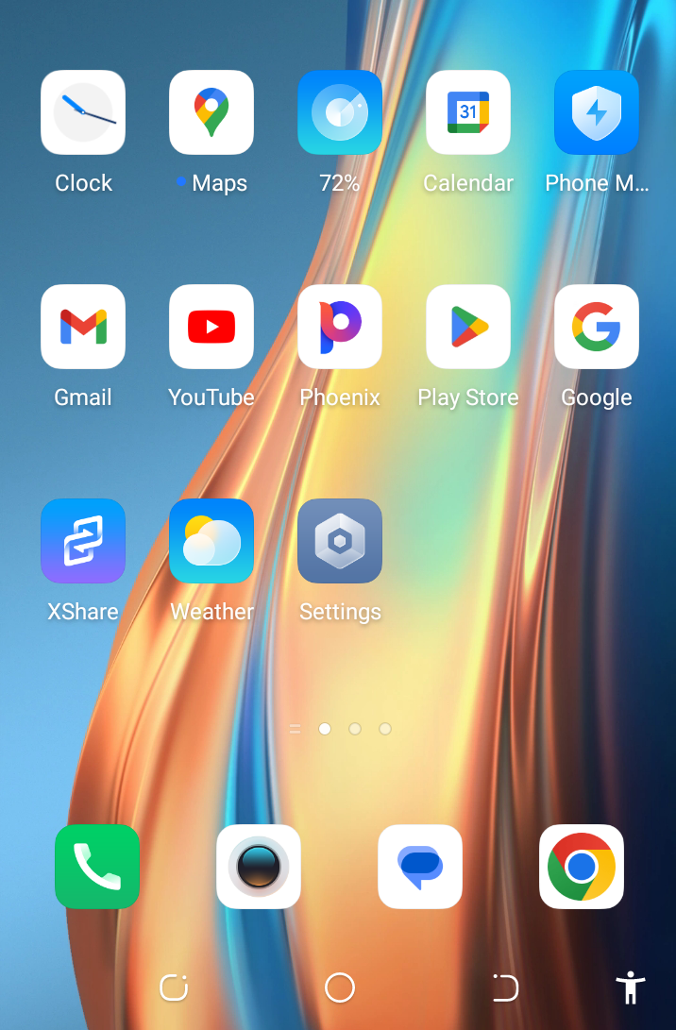
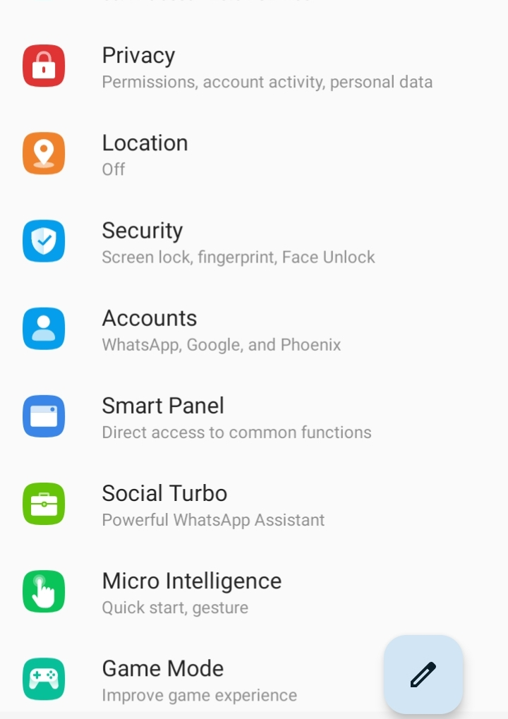
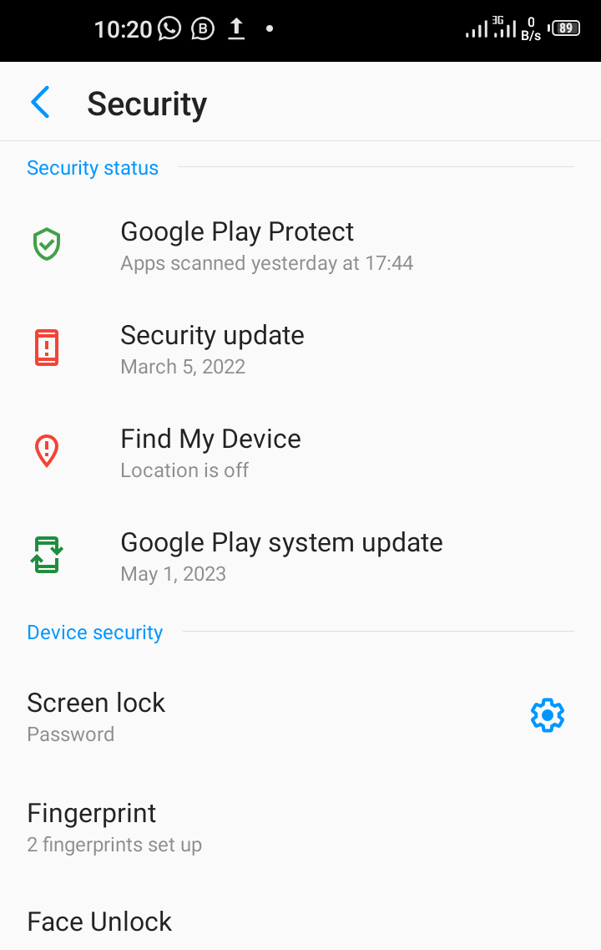
Graphical Explanations on the Steps taken
Click on Settings, select Security, click Find My Device.
Notes:
Click on settings

Slide 6
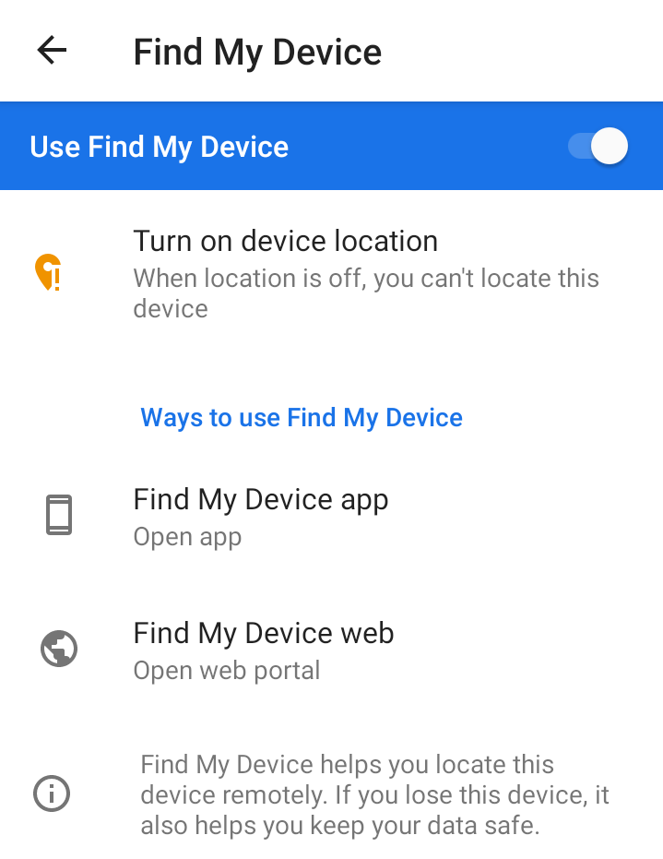
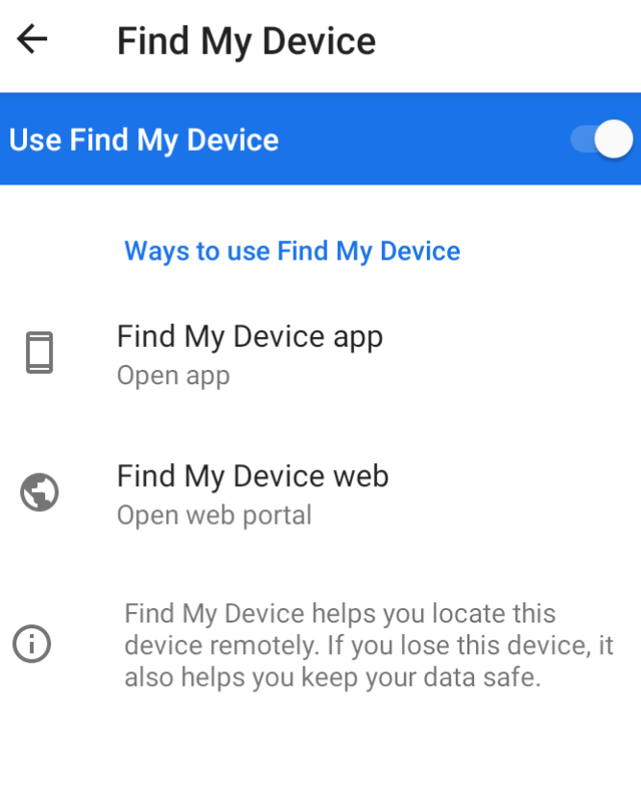
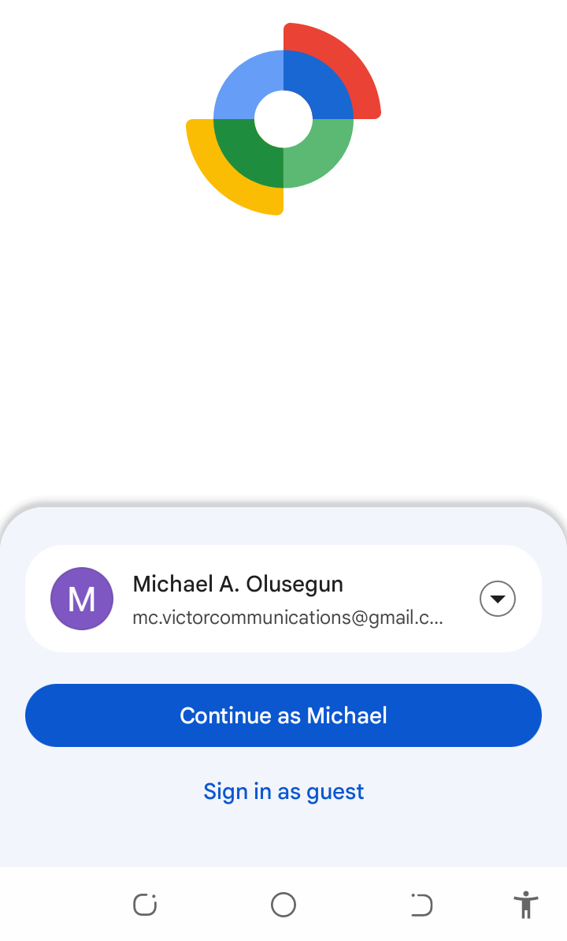
Graphical Explanations on the Steps taken
Select Turn on Device location, make it enabled, choose Find My Device app, it would up automatically, then sign in to the Gmail account registered on the misplaced Android Phone

Slide 7
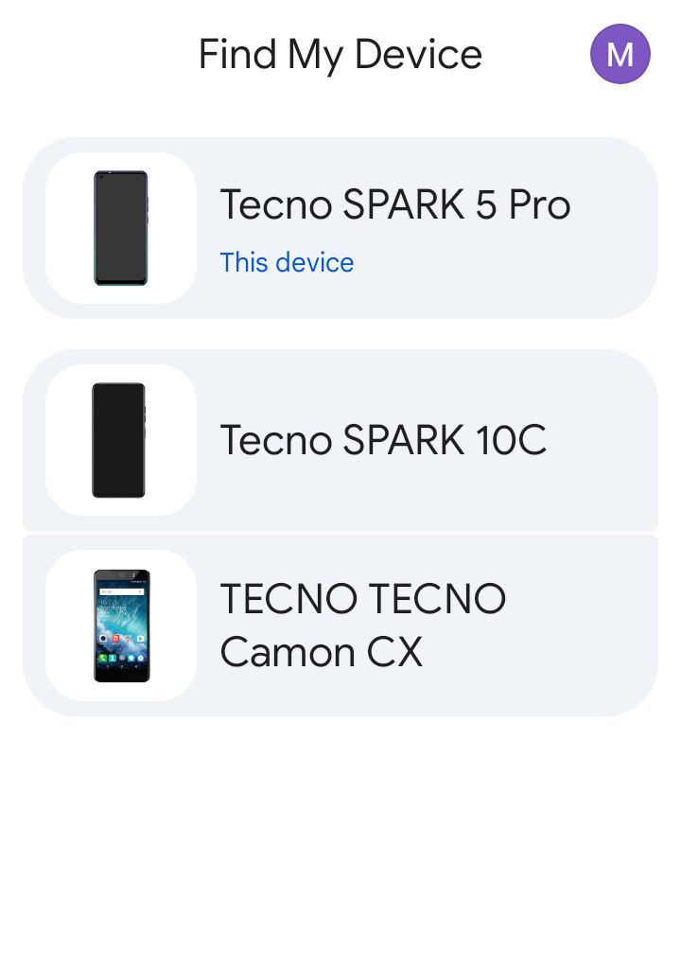
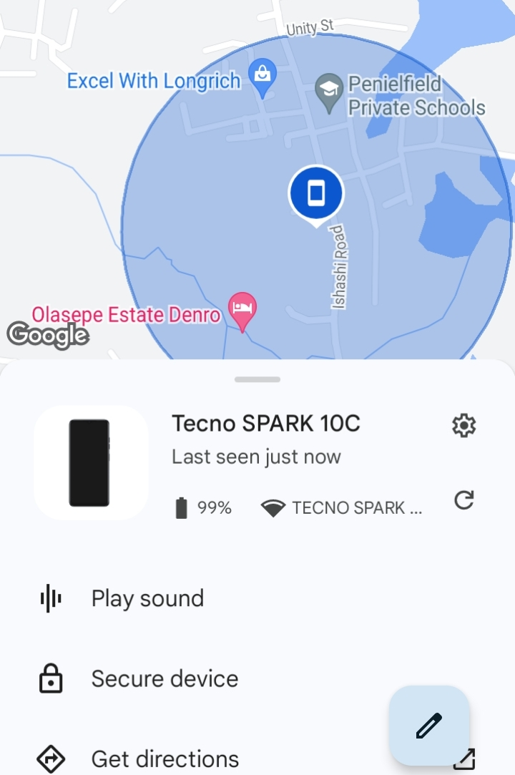
Graphical Explanations on the Steps taken
Immediately you log in, you would see a list of registered Gmail accounts used to log into the Phone you intend to use and Track/Locate Misplaced Phone. Here Tecno SPARK 10C was misplaced. So I selected the phone interface, and viewed its Location.

Slide 8
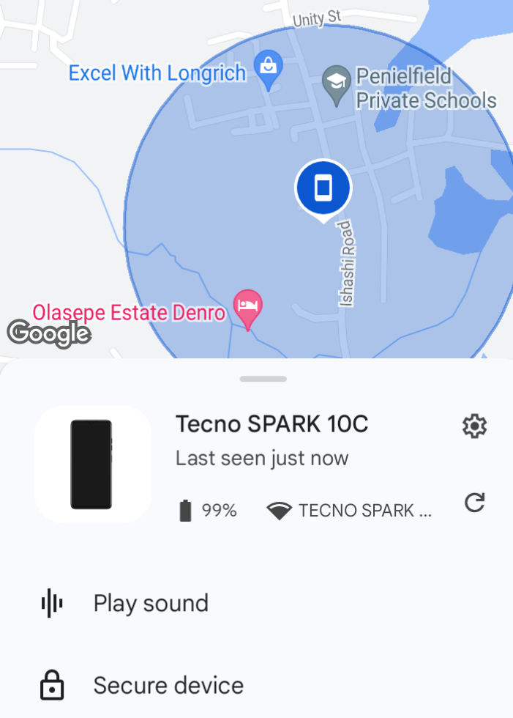
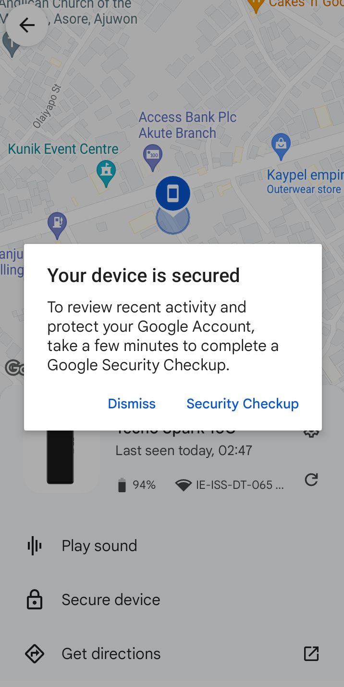
Graphical Explanations on the Steps taken
Using Google Find My Device, I was able to see what was going on the misplaced phone, immediately I pointed my finger on Secure device, and locked the Phone with immediate effect. On getting to the first location, someone that kept the Phone has changed location, and I tracked the phone again and saw the phone new location, and lastly gained the possession of the phone.

Slide 9
Closing remarks
It is advisable you enable Password, Find My Device, and Location settings on your Phone, helpful when tracking task is embarked on.
Moreover, enable ‘Developer Options’ on your Phone if it is not enabled, then disable ‘USB Debugging’ mode.
A misplaced or stolen Device/Phone is not secured when connected to a computer, confidential data and vital information can be copied authoritatively, using USB Debugging mode.
That is why some Organizations require you to turn this setting off.
Follow me on “https://github.com/Mikkytech” and read more of my upcoming projects.

